Slide 1
Analyzing the Impact of Car Features on Price and Profitability
Presented By: Mannat Sandhu
https://docs.google.com/spreadsheets/d/1xpB8XjCMoKzSL2WqTCL-8qA0RcJuZiZV/edit?usp=drive_link&ouid=101663467761144856859&rtpof=true&sd=true

Slide 2
Introduction
The automotive industry has been rapidly evolving over the past few decades, with a growing focus on fuel efficiency, environmental sustainability, and technological innovation.
With increasing competition among manufacturers and a changing consumer landscape, it has become more important than ever to understand the factors that drive consumer demand for cars.

Slide 3
Project Description
The dataset contains information on various car models and their specifications, and is titled "Car Features and MSRP".
It was collected and made available on Kaggle by Cooper Union, a private college located in New York City.

Slide 4

Tech-Stack Used
In this project I have used Microsoft excel 2010.

Slide 5
Approach
Download Data sets
Import data sets into MS Excel
Understanding the Datasets
Cleaning and preparing data for analysis.

Slide 6
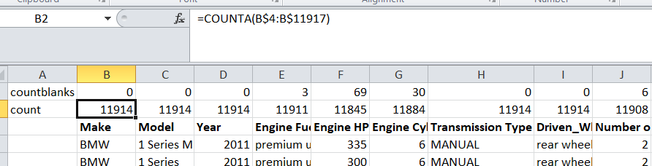
Data cleaning
In the given data we have 16 columns and 11914 rows.
First, we’ll calculate the number of blanks in each column using COUNTA and COUNTBLANK().

Slide 7
Engine Fuel Type: I have deleted 3 rows with null values of Suzuki Verona model.
Engine HP: We found 69 null values.
For Fiat, Honda, Kia, Nissan and Tesla I have imputed values with online available information.
For Chevrolet, Ford, Lincoln, Mercedes-Benz, Mitsubishi and Toyota the values are Impute with average of already available data of these brands.
Engine Cylinders: imputed number of cylinders as 0 because there are no cylinders present in Electric and Petrol Engine fuel types.

Slide 8
Transmission Type: used mode for replacing the unknown values with AUTOMATIC.
Number of Doors: imputed with online information.
Market Categories: N/A values are kept as it is.
Remove Duplicates: deleted 715 duplicate values from the Dataset and prepared the data for analysis.

Slide 9
Tasks: Analysis
How does the popularity of a car model vary across different market categories?
What is the relationship between a car's engine power and its price?
Which car features are most important in determining a car's price?
How does the average price of a car vary across different manufacturers?
What is the relationship between fuel efficiency and the number of cylinders in a car's engine?

Slide 10
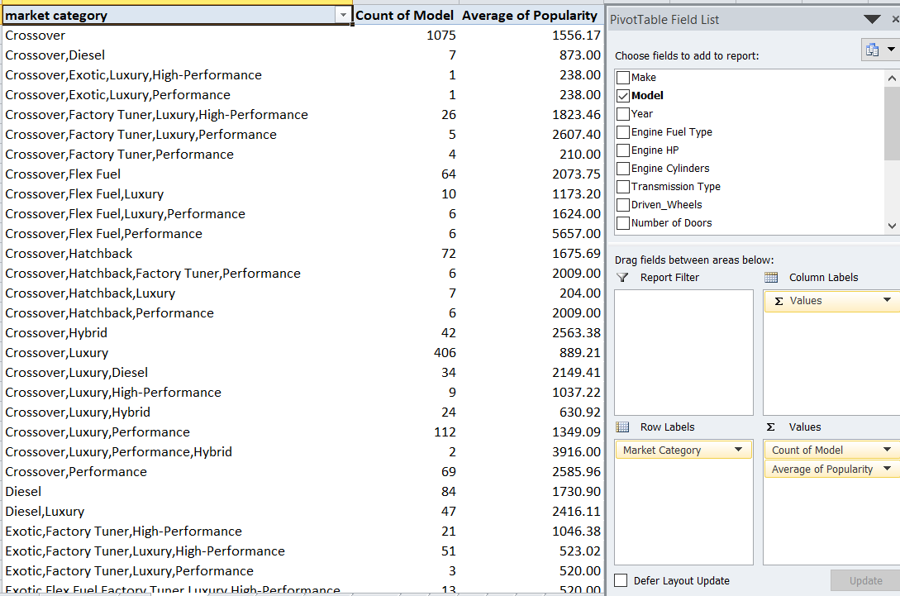
How does the popularity of a car model vary across different market categories
Task 1.a: we will create a pivot table using columns market category, model and popularity.

Slide 11
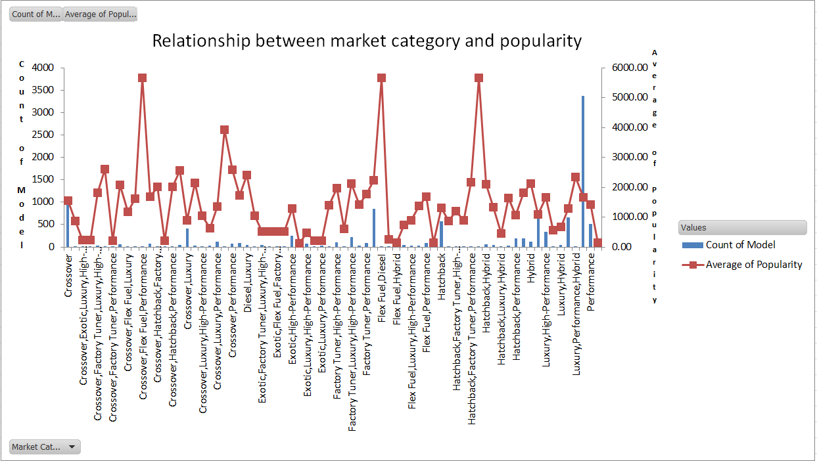
Task 1.b:Now we’ll create a combo chart from the pivot table to get relationship between market category and popularity.

Slide 12
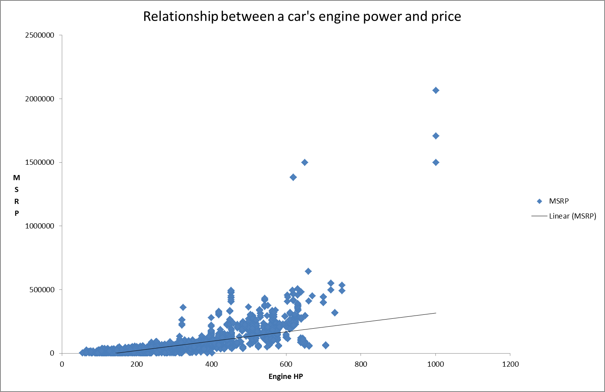
What is the relationship between a car's engine power and its price
Task 2: In this we’ll create a scatter plot using columns engine hp and MSRP.

Slide 13
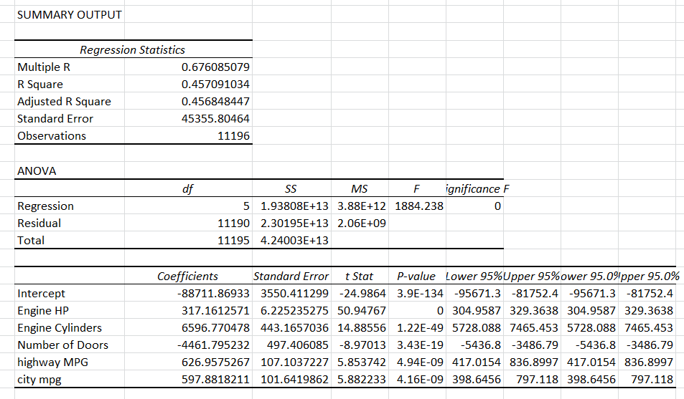
Which car features are most important in determining a car's price
Task 3: for this we’ll obtain regression analysis using data analysis option in data tab.

Slide 14
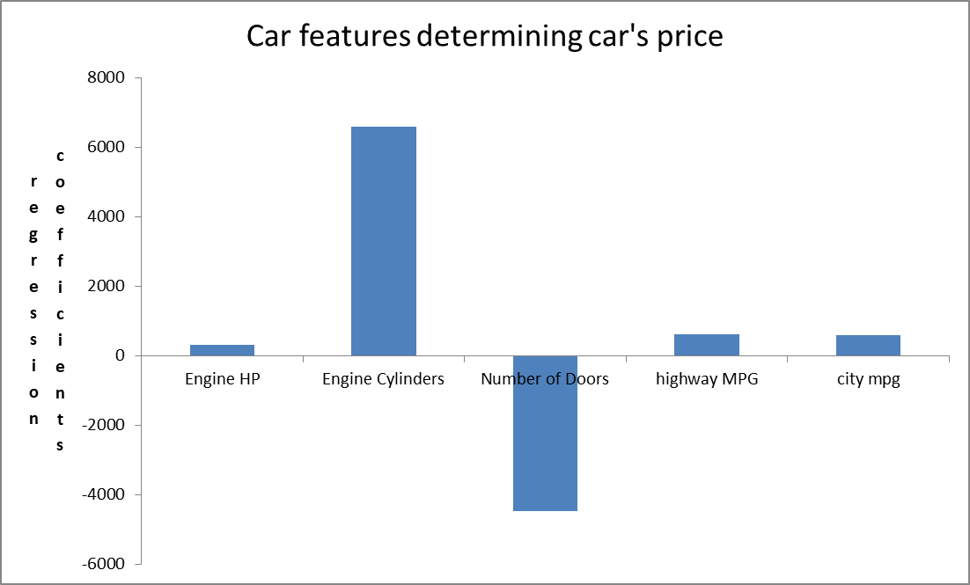
Using regression coefficients we’ll now plot a column chart.

Slide 15
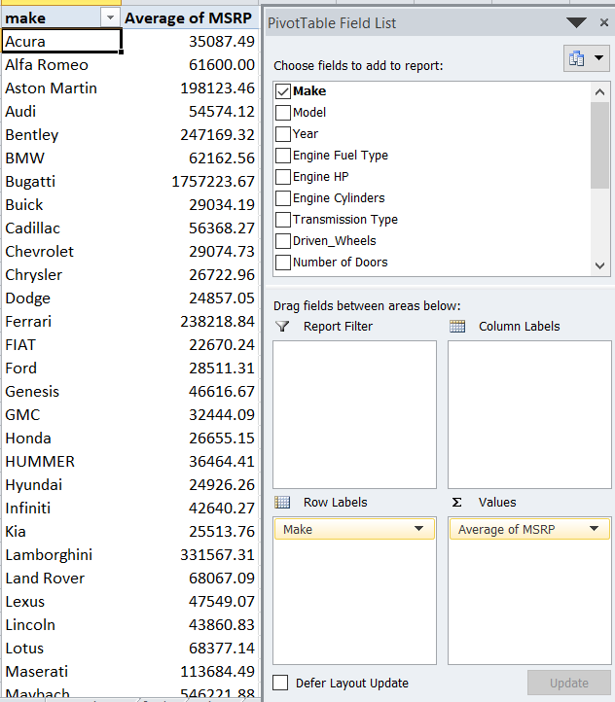
How does the average price of a car vary across different manufacturers
Task 4.A: we’ll create a pivot table for columns make and MSRP and obtain average MSRP for each manufacturer.

Slide 16
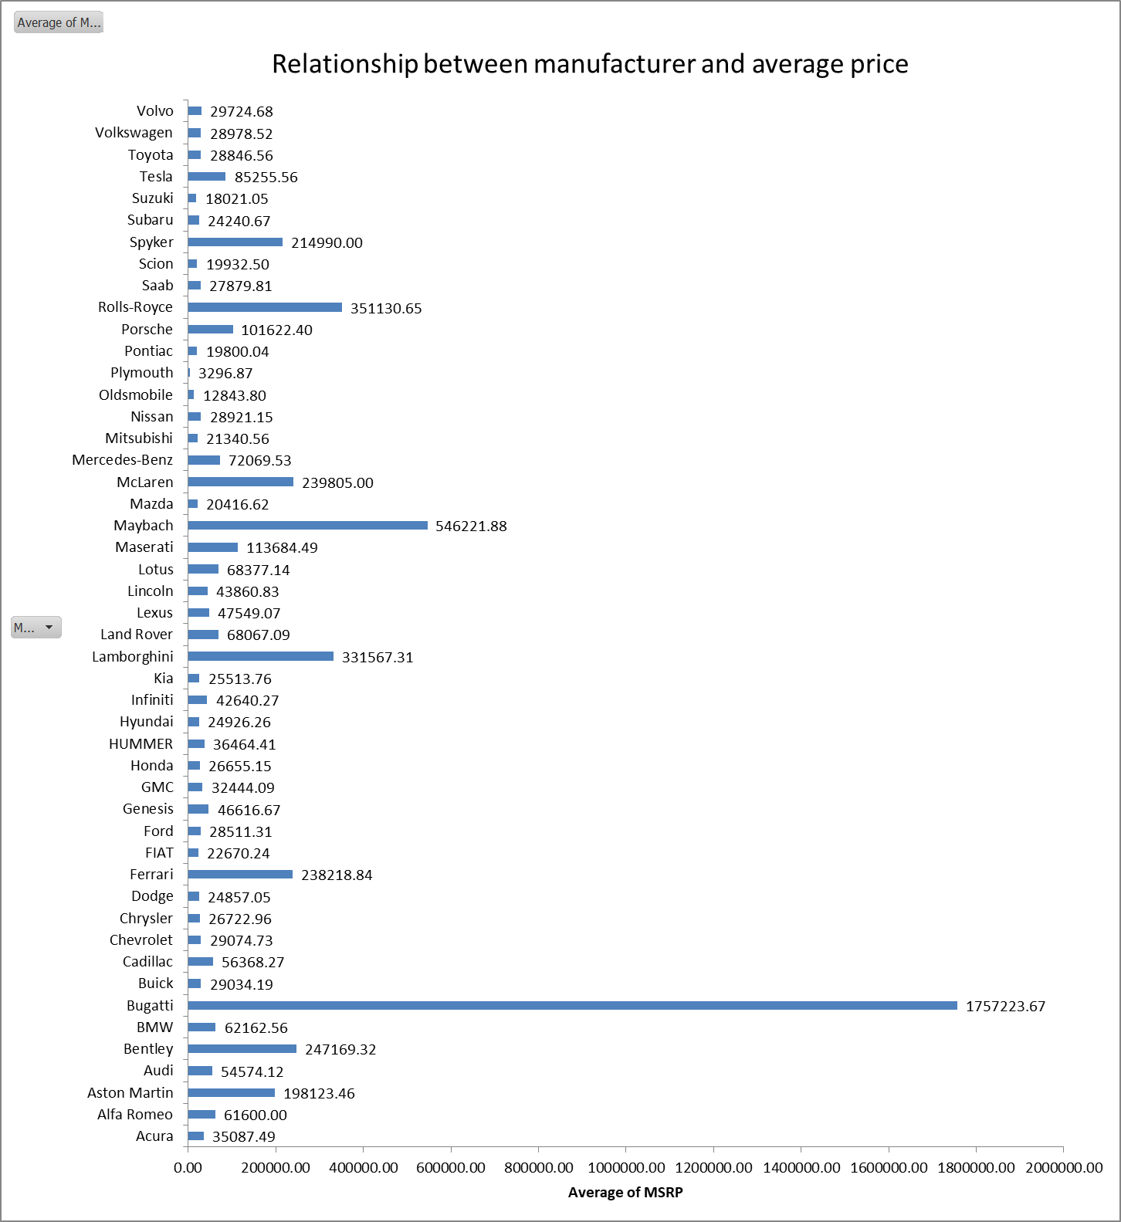
Task 4.B: plot a bar chart for average MSRP and manufacturers.

Slide 17
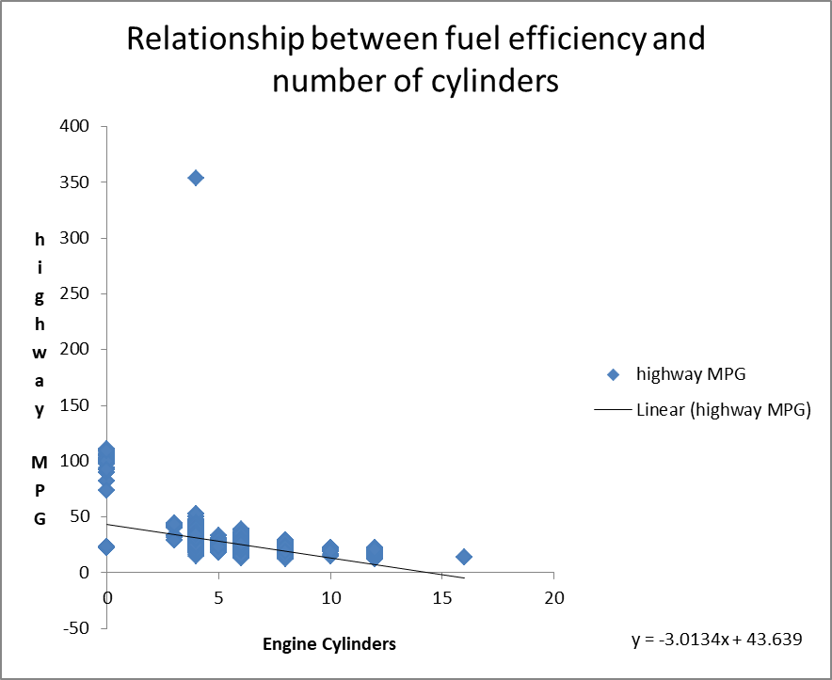
What is the relationship between fuel efficiency and the number of cylinders in a car's engine
Task 5.A: we’ll create a scatter plot for columns no. of cylinders and highway MPG.

Slide 18
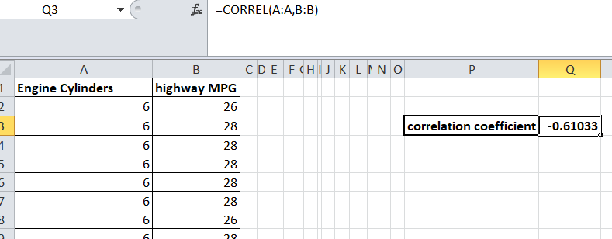
Task 5.B: we’ll obtain correlation coefficient using correl function.

Slide 19
Building the Dashboard:
How does the distribution of car prices vary by brand and body style?
Which car brands have the highest and lowest average MSRP’s and how does this vary by body style?
How do the different feature such as transmission type affect the MSRP and how does this vary by body style?
How does the fuel efficiency of cars vary across different body styles and model years?
How does the car's horsepower, MPG and price vary across different Brands?

Slide 20
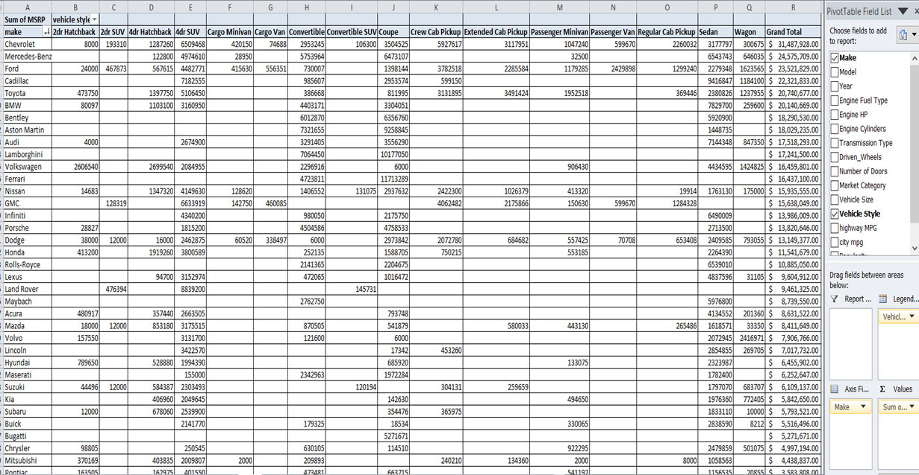
How does the distribution of car prices vary by brand and body style
Task 1: create a pivot table using make, vehicle style and MSRP and obtain sum of MSRP for different car styles of manufacturers.

Slide 21
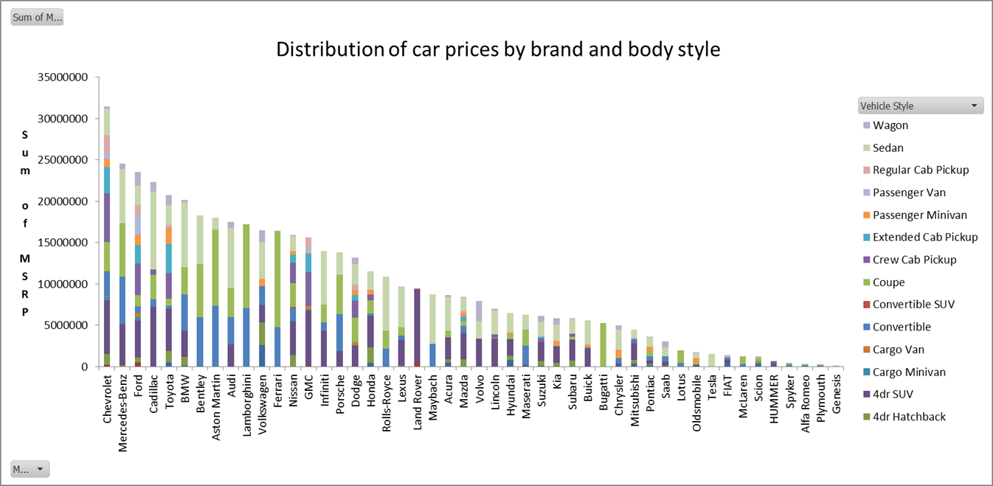
Now create a stacked column chart.

Slide 22
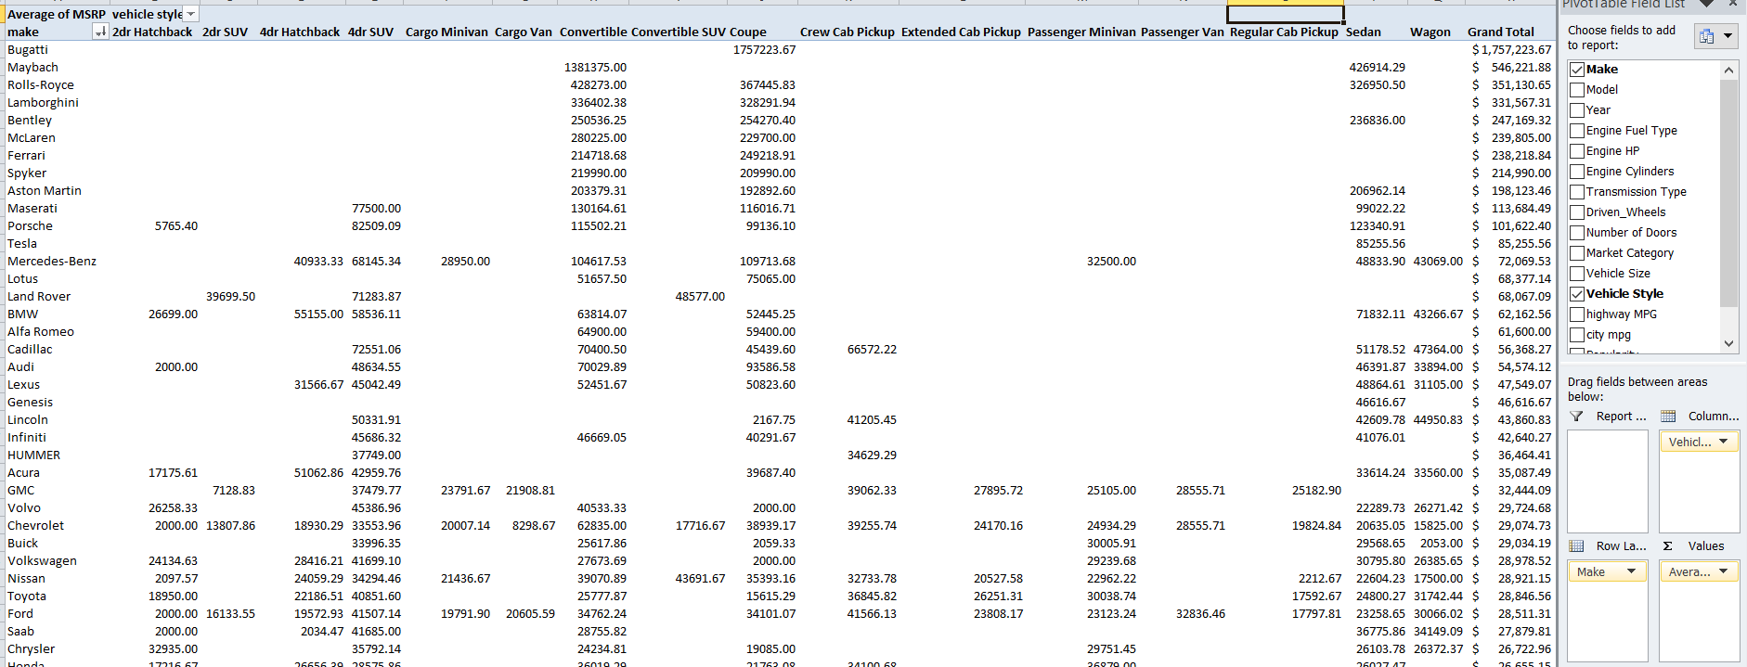
Which car brands have the highest and lowest average MSRP’s and how does this vary by body style
Task 2: for this task we’ll calculate the average of MSRP for each vehicle style of a manufacturer using pivot table.

Slide 23
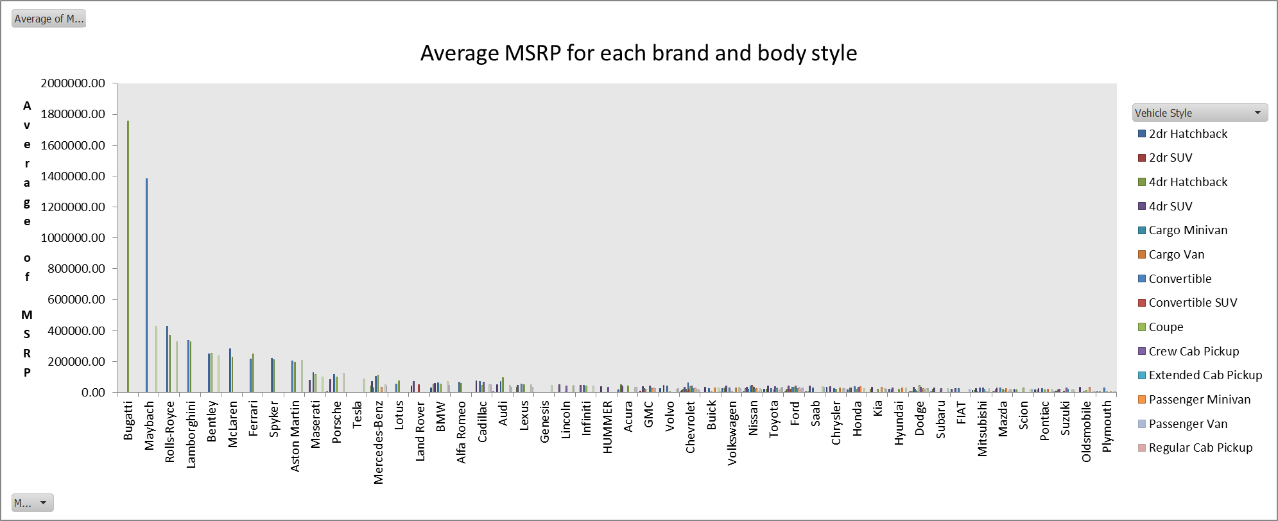
Now create a clustered column chart.

Slide 24
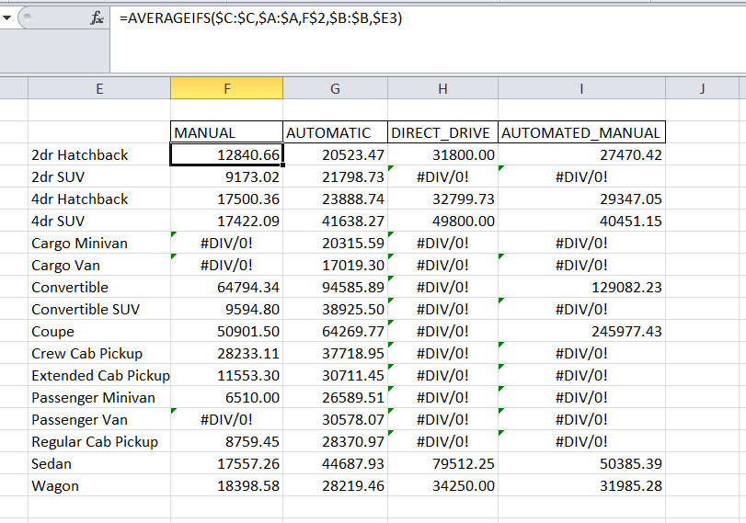
How do the different feature such as transmission type affect the MSRP and how does this vary by body style
Task 3: in this task we’ll obtain the average MSRP for each combination of transmission type and vehicle style using AVERAGEIFS.

Slide 25
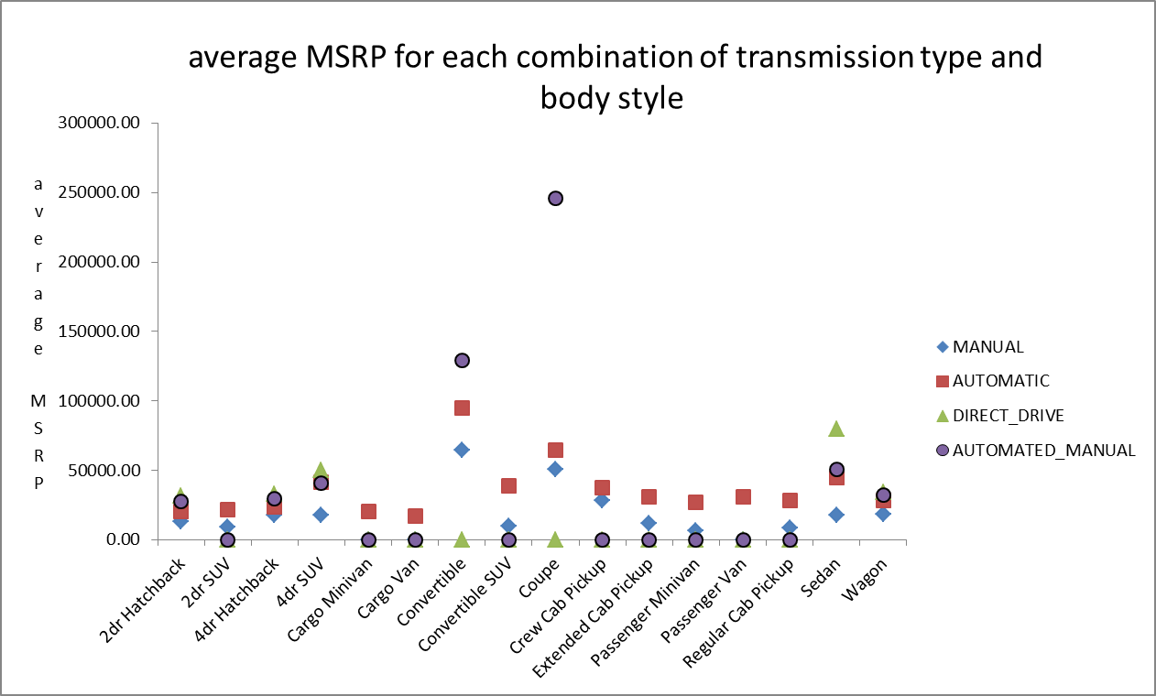
Now we’ll create a scatter plot.

Slide 26
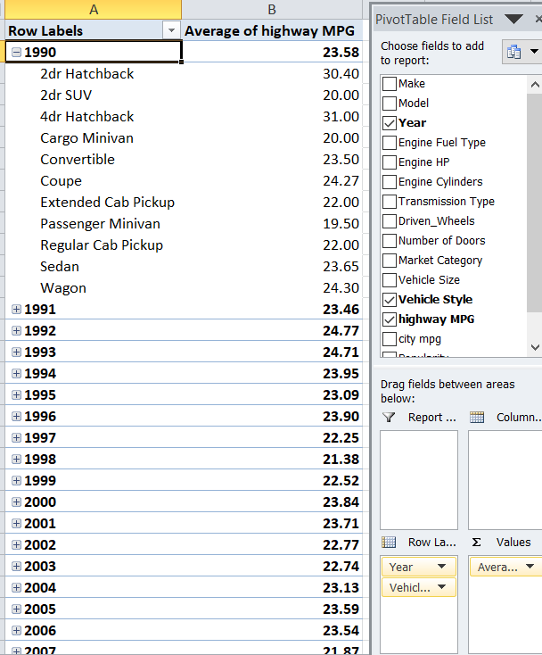
How does the fuel efficiency of cars vary across different body styles and model years
Task 4: for this we’ll create a pivot table for columns year, vehicle style and highway MPG.

Slide 27
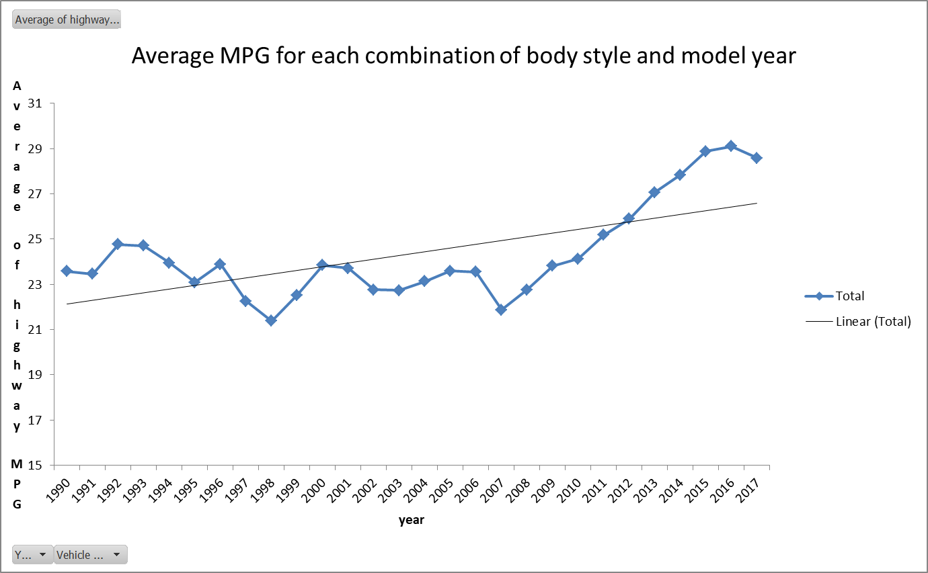
Now we’ll create a line chart for average MPG of each body style and year.

Slide 28
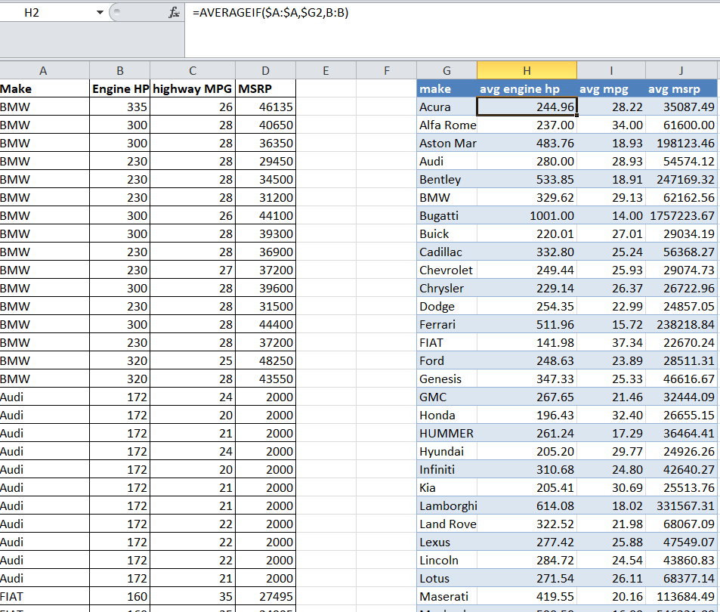
How does the car's horsepower, MPG and price vary across different Brands
Task 5: in this task we’ll calculate the average horsepower, MPG, and MSRP for each car brand using AVERAGEIF

Slide 29
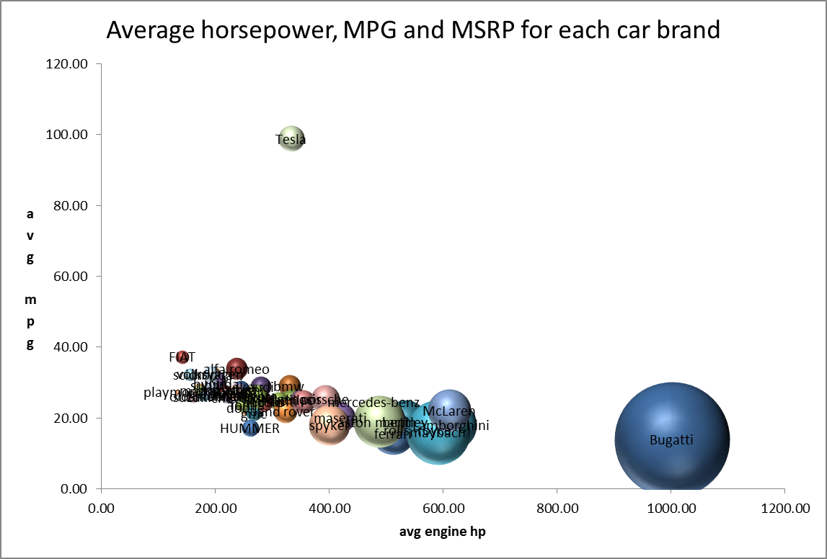
Now we’ll create the bubble chart where avg engine hp is on x-axis, avg MPG on y-axis and size of bubble depicts avg price.

Slide 30
Insights
Analysis:
Task 1: average popularity of a car doesn’t depends upon count of model across different market categories as crossover, flex fuel, performance have highest average popularity but count of models is just 6.
Task 2: there is a linear relationship between engine power and price as power increases the price also increases.
Task 3: the most important feature determining car’s price is no of engine cylinders in a car.
Task 4: the average price for Bugatti is highest.
Task 5: inverse linear relationship between fuel efficiency and number of cylinders in a car; as no of cylinders increases the fuel efficiency decreases.

Slide 31
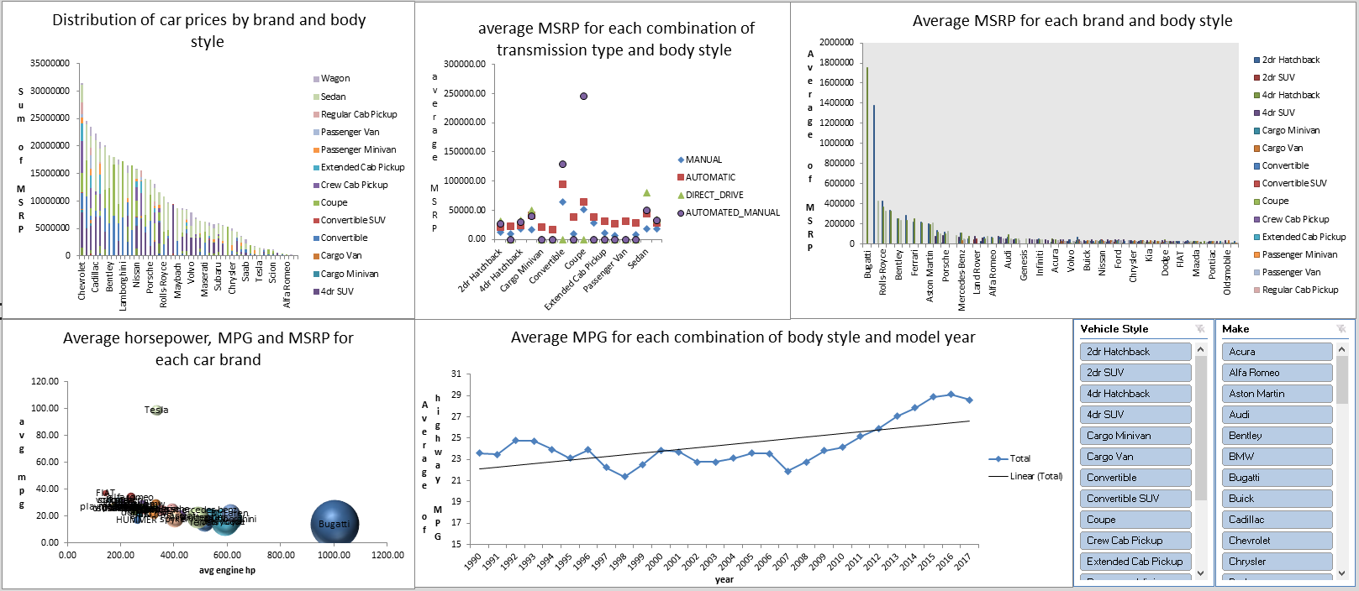
Result

